Slide 1
Intersection of Solids
ME 111 Engineering Drawing
2016

Slide 2
INTERPENETRATION OF SOLIDS
WHEN ONE SOLID PENETRATES ANOTHER SOLID THEN THEIR SURFACES INTERSECT
AND
AT THE JUNCTION OF INTERSECTION A TYPICAL CURVE IS FORMED,
WHICH REMAINS COMMON TO BOTH SOLIDS.
THIS CURVE IS CALLED CURVE OF INTERSECTION
AND
IT IS A RESULT OF INTERPENETRATION OF SOLIDS.
PURPOSE OF DRAWING THESE CURVES:-
WHEN TWO OBJECTS ARE TO BE JOINED TOGATHER, MAXIMUM SURFACE CONTACT BETWEEN BOTH
BECOMES A BASIC REQUIREMENT FOR STRONGEST & LEAK-PROOF JOINT.
Curves of Intersections being common to both Intersecting solids,
show exact & maximum surface contact of both solids.
Study Following Illustrations Carefully.
Minimum Surface Contact.
( Point Contact)
(Maximum Surface Contact)
Lines of Intersections.
Curves of Intersections.
Square Pipes.
Circular Pipes.
Square Pipes.
Circular Pipes.

Slide 3
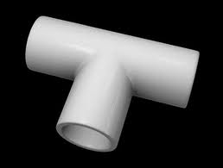
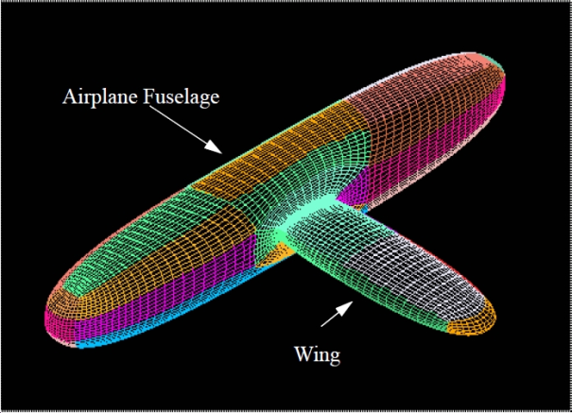
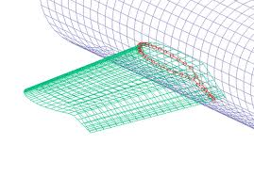
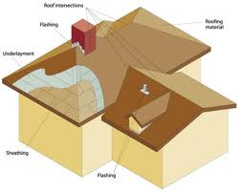
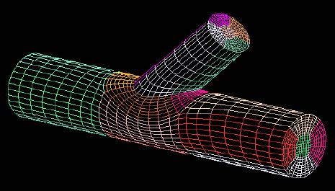
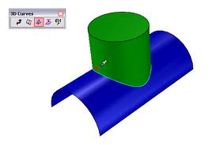
Introduction
Solids in real world in general
Combination of two or more solids
Definite curve can be seen at intersection of solids
Curve of intersection (COI)
COI is common to the intersecting solids

Slide 4
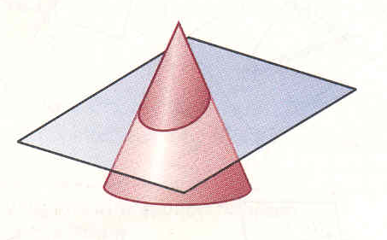
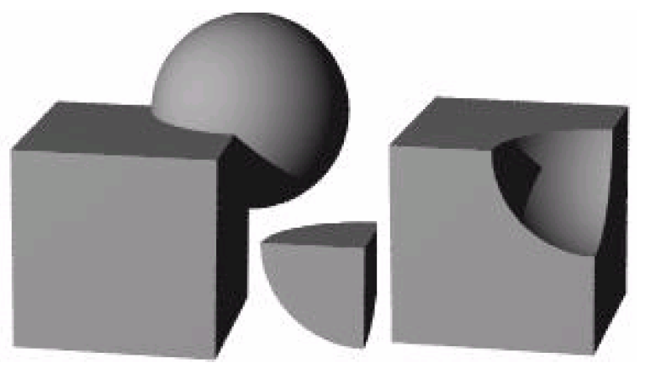
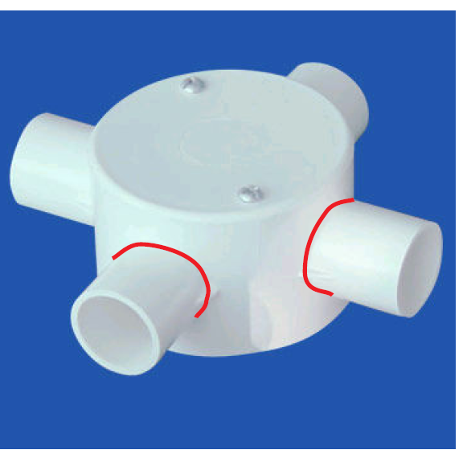
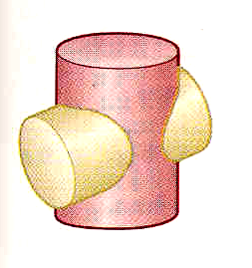

Slide 5
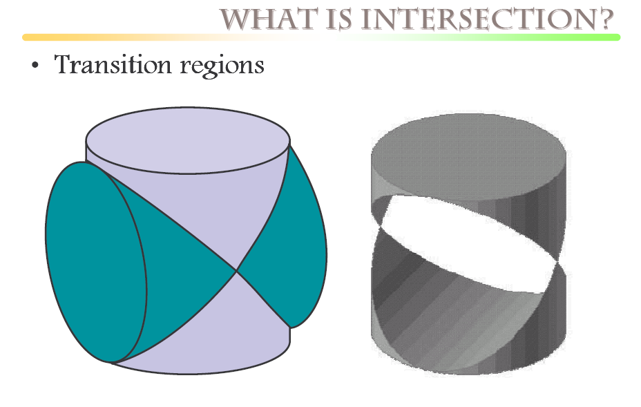

Slide 6
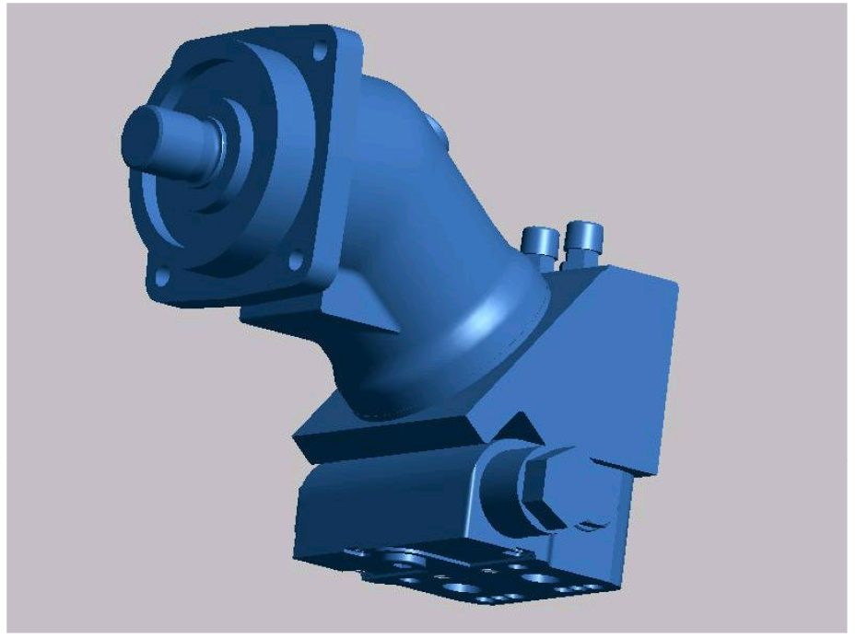

Slide 7
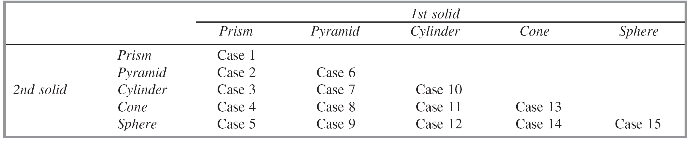
Cases of Intersection
The cases of intersection depend on
Type of intersecting solids, and
Manner in which they intersect.
When two solids bounded by plane surfaces such as prism and pyramid penetrate each other, we obtain straight lines as their line of intersection.

Slide 8
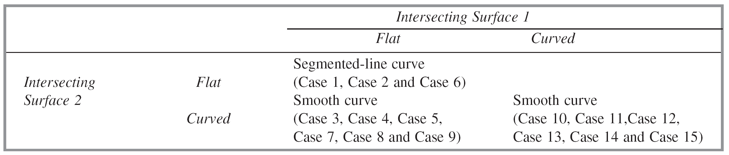
Cases of Intersection
Line of intersection between a plane surface and a curved surface of two solids such as prism and cylinder is a curve.
The line of intersection between two curved surfaces of solids such as cylinder and cone is a curve.
Manner in which solids intersect:
(i) Axis perpendicular and intersecting (ii) Axis perpendicular and offset
(iii) Axis inclined and intersecting (iv) Axis inclined and offset
(v) Axis parallel and coinciding (vi) Axis parallel and offset

Slide 9
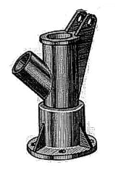
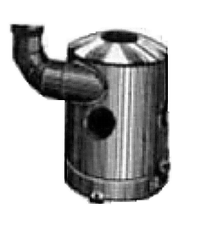
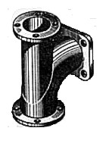
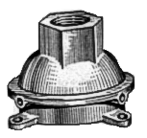
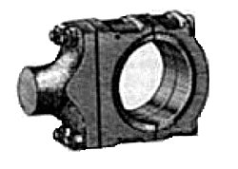
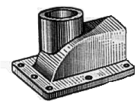
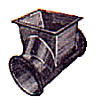
SOME ACTUAL OBJECTS ARE SHOWN, SHOWING CURVES OF INTERSECTIONS.
BY WHITE ARROWS.
A machine component having
two intersecting cylindrical
surfaces with the axis at
acute angle to each other.
An Industrial Dust collector.
Intersection of two cylinders.
Intersection of a Cylindrical
main and Branch Pipe.
Pump lid having shape of a
hexagonal Prism and
Hemi-sphere intersecting
each other.
A Feeding Hopper
In industry.
Forged End of a
Connecting Rod.
Two Cylindrical
surfaces.

Slide 10
FOLLOWING CASES ARE SOLVED.
REFFER ILLUSTRATIONS
AND
NOTE THE COMMON
CONSTRUCTION
FOR ALL
COMMON SOLUTION STEPS
One solid will be standing on HP
Other will penetrate horizontally.
Draw three views of standing solid.
Name views as per the illustrations.
Beginning with side view draw three
Views of penetrating solids also.
On it’s S.V. mark number of points
And name those(either letters or nos.)
The points which are on standard
generators or edges of standing solid,
( in S.V.) can be marked on respective
generators in Fv and Tv. And other
points from SV should be brought to
Tv first and then projecting upward
To Fv.
Dark and dotted line’s decision should
be taken by observing side view from
it’s right side as shown by arrow.
Accordingly those should be joined
by curvature or straight lines.
1.CYLINDER TO CYLINDER2.
2.SQ.PRISM TO CYLINDER
3.CONE TO CYLINDER
4.TRIANGULAR PRISM TO CYLNDER
5.SQ.PRISM TO SQ.PRISM
6.SQ.PRISM TO SQ.PRISM
( SKEW POSITION)
7.SQARE PRISM TO CONE ( from top )
8.CYLINDER TO CONE
Note:
Incase cone is penetrating solid Side view is not necessary.
Similarly in case of penetration from top it is not required.

Slide 11
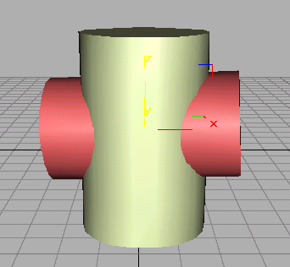
Problem: A cylinder 50mm dia.and 70mm axis is completely penetrated
by another of 40 mm dia.and 70 mm axis horizontally Both axes intersect
& bisect each other. Draw projections showing curves of intersections.
CASE 1.
CYLINDER STANDING
&
CYLINDER PENETRATING
1”
2’
4”
3”
2”
1’
4’
3’
a’
a”
b ’h’
h”
b”
c’g’
g”
c”
d’f’
f”
d”
a’
e”
X
Y
4
1
3
2

Slide 13
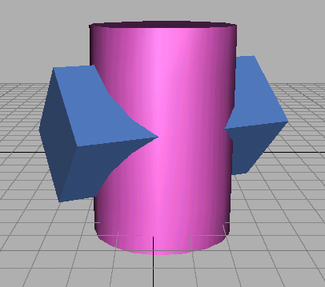
Problem: A cylinder 50mm dia.and 70mm axis is completely penetrated
by a square prism of 25 mm sides.and 70 mm axis, horizontally. Both axes
Intersect & bisect each other. All faces of prism are equally inclined to Hp.
Draw projections showing curves of intersections.
CASE 2.
CYLINDER STANDING
&
SQ.PRISM PENETRATING
1”
2’
4”
3”
2”
1’
4’
3’
a’
a’
a”
b’
b’
d”
b”
d’
d’
c’
c’
c”
X
Y
4
1
3
2

Slide 14
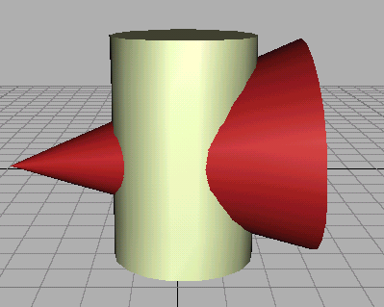
Problem: A cylinder of 80 mm diameter and 100 mm axis
is completely penetrated by a cone of 80 mm diameter and
120 mm long axis horizontally.Both axes intersect & bisect
each other. Draw projections showing curve of intersections.
CASE 3.
CYLINDER STANDING
&
CONE PENETRATING
7’
6’ 8’
1’ 5’
2’ 4’
3’
X
Y
1
2 8
3 7
4 6
5

Slide 15
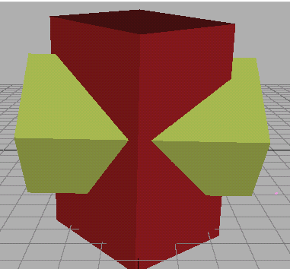
Problem: A sq.prism 30 mm base sides.and 70mm axis is completely penetrated
by another square prism of 25 mm sides.and 70 mm axis, horizontally. Both axes
Intersects & bisect each other. All faces of prisms are equally inclined to Vp.
Draw projections showing curves of intersections.
CASE 4.
SQ.PRISM STANDING
&
SQ.PRISM PENETRATING
2’
1’
4’
3’
1”
4”
3”
2”
a’
a’
a”
b’
b’
d”
b”
d’
d’
c’
c’
c”
X
Y
4
1
3
2

Slide 16
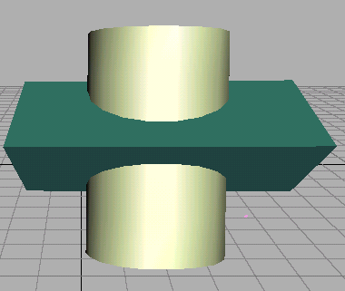
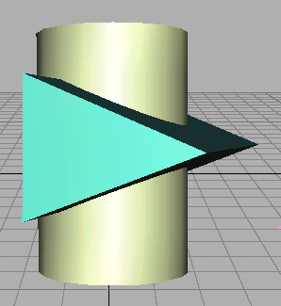
Problem: A cylinder 50mm dia.and 70mm axis is completely penetrated
by a triangular prism of 45 mm sides.and 70 mm axis, horizontally.
One flat face of prism is parallel to Vp and Contains axis of cylinder.
Draw projections showing curves of intersections.
CASE 5. CYLINDER STANDING & TRIANGULAR PRISM PENETRATING
1”
2’
4”
3”
2”
1’
4’
3’
a
a
a
b
b
b
c
c
d
e
e
d
e
f
f
f
X
Y
4
1
3
2

Slide 17
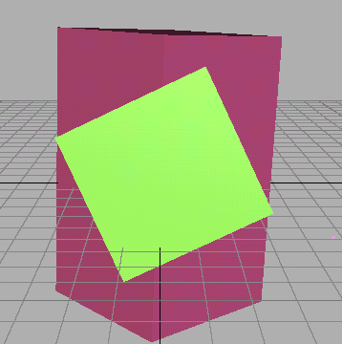
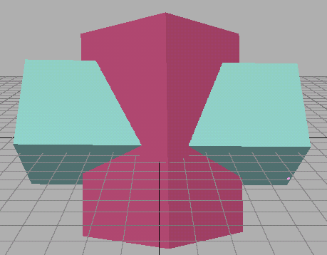
Problem: A sq.prism 30 mm base sides.and 70mm axis is
completely penetrated by another square prism of 25 mm side
s.and 70 mm axis, horizontally. Both axes Intersect & bisect
each other.Two faces of penetrating prism are 30⁰ inclined to Hp.
Draw projections showing curves of intersections.
CASE 6.
SQ.PRISM STANDING
&
SQ.PRISM PENETRATING
(30⁰ SKEW POSITION)
2’
1’
4’
3’
1”
4”
3”
2”
a’
f”
a”
f’
e’
e”
b”
b’
c’
c”
d’
d”
X
30⁰
Y
4
1
3
2

Slide 18
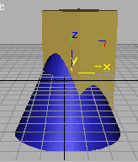
CASE 7.
CONE STANDING & SQ.PRISM PENETRATING
(BOTH AXES VERTICAL)
2’
1’
3’
5’
4’
6’
X
a’ b’h’ c’g’ d’f’ e’
Y
g
h
8
f
9
7
10
6
Problem: A cone70 mm base diameter and 90 mm axis
is completely penetrated by a square prism from top
with it’s axis // to cone’s axis and 5 mm away from it.
a vertical plane containing both axes is parallel to Vp.
Take all faces of sq.prism equally inclined to Vp.
Base Side of prism is 0 mm and axis is 100 mm long.
Draw projections showing curves of intersections.
a
1
e
2
3
5
b
4
d
c
5 mm OFF-SET

Slide 19
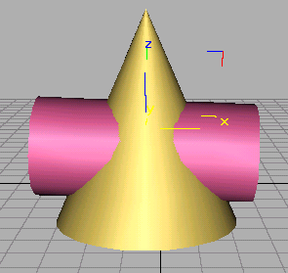
Problem: A vertical cone, base diameter 75 mm and axis 100 mm long,
is completely penetrated by a cylinder of 45 mm diameter. The axis of the
cylinder is parallel to Hp and Vp and intersects axis of the cone at a point
28 mm above the base. Draw projections showing curves of intersection.
CASE 8.
CONE STANDING
&
CYLINDER PENETRATING
o’
o”
1
1
2
2
1
8,
8
2
3
3
7
3
7,
4
6
4
6
4
5
5
5
X
a’ b’h’ c’g’ d’f’ e’
g” g”h” a”e” b”d” c”
Y
g
h
f
a
e
b
d
c

